Slide 1

SAGE gameful Constructionism Assessments Psl Lab session December 8th, 2017
Johan sulaiman

Slide 2

agenda
MOTIVATION
RELATED WORK
PROPOSAL
MILESTONES
FUTURE WORK

Slide 3
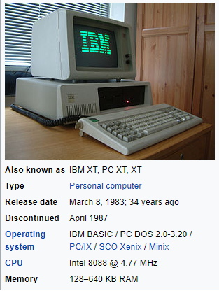
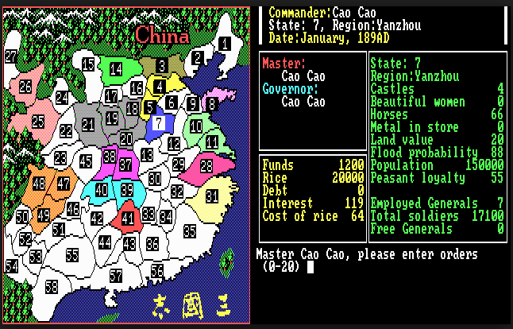
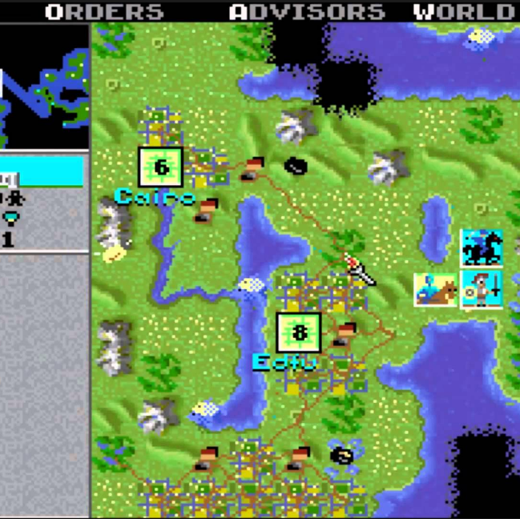
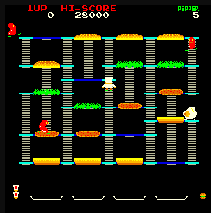
personal Motivation from an overcommitted gamer
Gaming is my life’s first passion. Started with Burger Time and in PC XT, but Civilization I(!) and ROTK sealed my enduring life-long love affair with games. It brought me immense happiness internalizing the growth, accomplishments, and the evolving game world of my character, team, or civilization into my real waking moments.
I later realized that my game playing sessions were my safe, controlled, simulated projections of how I want my ideal life to be. But I fell into the too common trap to permanently migrate and stay in the safe and controlled game world. I learned the hard way it would be a tragic waste of time, passion and potential if gamers who have worked hard in gaining virtualized skills and experiences could not convert these investments in their day-to-day lives.
Now that I have little children, I want to find ways for them (and their friends!) to turn highly enjoyable and rewarding game playing into directly translatable life skills, incentivizing them from mere Player of games into Constructionists in simulated game worlds, and in the real world where it matters the most.

Slide 4

motivation– three years of sage at a glimpse
Tooling Scratch – Jeff Bender
1
Formative SAGE Assessments – Jairo Pava
2
Foundations for Gamification for Formative SAGE Assessments – Iris Zhang, Julie Chien, Ray Tsai
3
SAGE Assessments Parson’s Puzzles - Akanksha Gupta, Sudhanshu Mohan
4
SAGE Dashboard – Ruicong Xie, Tianci Zhong
5
Enhanced Data Collection, Student Progress Modeling, and Intelligent Hinting in SAGE– Sambhav Anand, Allison Sawyer
6
Computational Thinking Learning Platform for SAGE - Sajal Khandelwal, Plaban Mohanty
Scratch Analyzer – Jeff Bender

Slide 5
motivation–sage modules
Scratch Analyzer
Assessment Server
Visual Assessment Editor
SAGE Scratch Editor
SAGE Dashboard/
Affinity Space
Sage Machine Learning

Slide 6
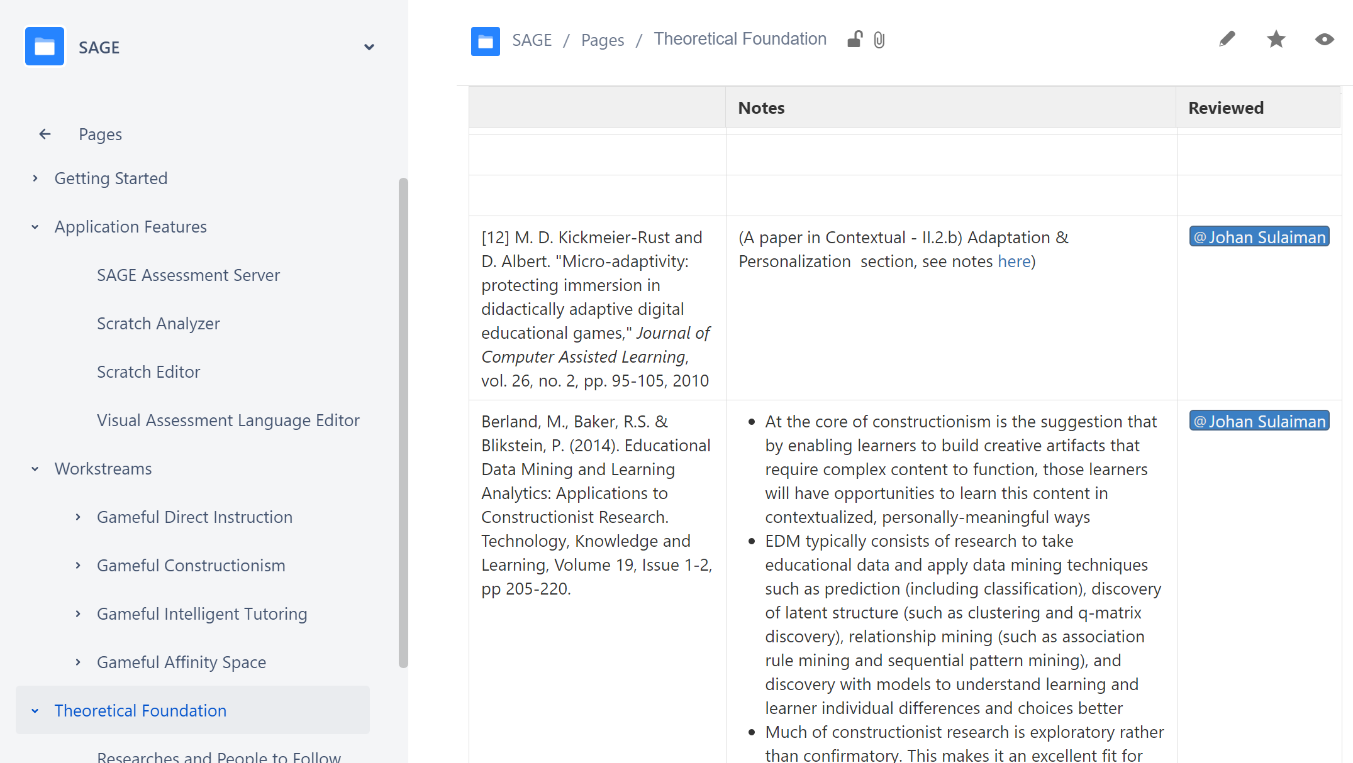
SAGE Wiki overview

Slide 7
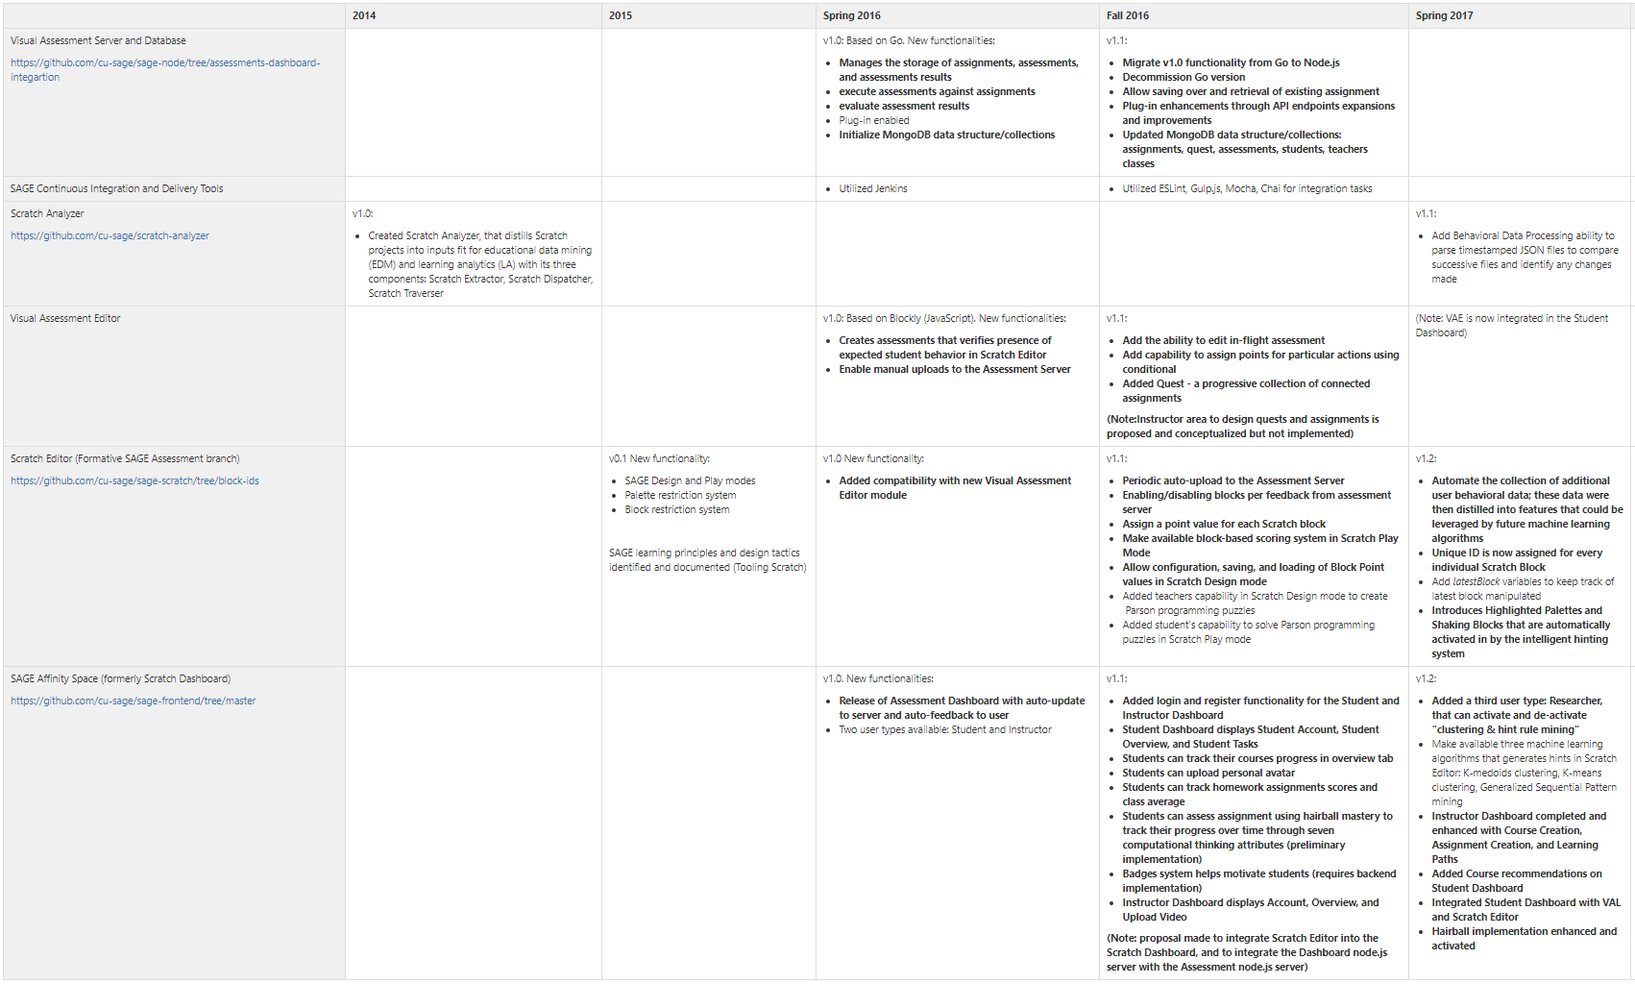
SAGE Wiki - Evolution of SAGE Modules and Functionalities
https://gudangdaya.atlassian.net/wiki/spaces/SAGE/pages/60293127/Getting+Started

Slide 8
motivation– theme from the past: we want to experiment with more users and more data!
Feedback loop for machine learning algorithm: “Eventually, it will be necessary to have a larger sample of student users in the target sixth- to eighth-grade range try SAGE. This student data would strengthen models of how different clusters of students approach puzzles. It would also allow for empirical evaluations of the usefulness and appropriateness of the hinting system.” – Allison, Sambhav
“Also, as we propose to open this platform to the community, over time we may have influx of courses of different qualities. Instead of manually implementing quality control with human intervention, we propose to implement a rank based model identify better quality courses. The rank could be calculated in combination of factors like users’ ratings, number of completed courses, comprehensiveness etc.” – Sajal, Plaban
“Does gamified SAGE work better than regular SAGE?” – Julie, Iris, Ray
Notes:
Another aspect of this proposal as indicated from the title is: analytics. From previous developments of SAGE, there has been a common theme of the need to quantitatively assess the effectiveness of SAGE gamification features. We want to know how SAGE performs in developing CT thinking compared to regular Scratch. Additionally, we want to know if a gamified SAGE is more or as effective as regular SAGE, as the previous report by Julie, Iris, and Ray indicates.

Slide 9
motivation– …which requires a more generally accessible unified implementation
“Building a one-stop platform for SAGE, all components - Dashboard, Scratch Editor, Visual Assessment Language etc. under one web platform may lead to better engagement” – Sajal, Plaban
“Combine Front-end website, SAGE editor, and SAGE assessment server into a single repository and server. Integrate the SAGE editor into current dashboard design” – Ruicong, Tianci
“Improve service architecture to make the assessment editor more integrated with the rest of the SAGE and Scratch suite. Create a live server using Heroku or OpenShift” – Julie, Iris, Ray
“"An evaluation of the project should be conducted in a classroom environment where its strengths may be built upon and its weaknesses addressed. Future work should aim towards further analysis of how the puzzles can be designed in this project can be improved to better capture a student’s computational thinking progress over time." - Akanksha, Sudhanshu

Slide 10
Project Motivation
The past 3 years of SAGE development has created various modules and functionalities. Our continued focus remains in maximizing Social Addictive Gamefulness during instillation of computational thinking especially during assessments of Gameful Constructionism learning, but with the added awareness that there is also a growing need to provide up-to-date, unifying structure on the conceptual and architectural level with a Gameful orientation. In an iterative manner, during the process of building a platform that supports Engineering activities, the platform itself requires frequent (Re-)Engineering. Achieving this will allow for better cross-module integration, research clarity, and enablement of a more formal experimentation and evaluation of the effectiveness of SAGE modules.

Slide 11
Related work – constructionism Papers
Construction tools must be sufficiently expressive to allow sufficient range of freedom that yields creativity, and in-game goals should encourage exploration (“Redefining constructionist video games”, Weintrop et al, 2012)
In particular, constructionism is itself resistant to grading, ranking, and classifying children as bad/underachievers, because inherent in the idea of constructionism is that all students can engage in deep learning if the environment, tools, and facilitation are well-designed (Berland et al, 2014)
Constructionist games do provide a wealth of unstructured data conducive for application of data mining techniques (Berland, Baker, Blikstein, 2014)
So how to best assess constructionism given this challenge?
https://gudangdaya.atlassian.net/wiki/spaces/SAGE/pages/75595790/Theoretical+Foundation

Slide 12
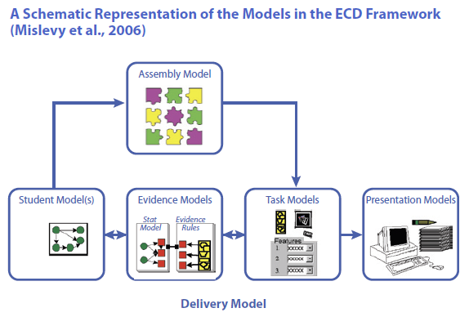
Related work – ECD Papers
“Evidence-centered design of epistemic games” (Rupp et al, 2010) and “Serious games for learning” (Carvalho, 2017):
a learner’s performance data is continuously collected from the game, and machine-based reasoning techniques are used to make inferences about the learner’s competences across a network of competences and skills resulting in a learner model. It is argued that stealth assessment and ECD are able to assess not only content-specific learning but also general abilities, dispositions and beliefs, thus being more adequate to assess the so-called 21st century competences (problem-solving skills, persistence, creativity, etc.)
As any empirical measurement, assessment in learning has two important properties: reliability and validity. Reliability refers to the amount of error in a test, or the extent that the assessment yields the same results on repeated trials; validity concerns the extent that the assessment measures what it is intended to measure (Carmines & Zeller, 1979)
https://gudangdaya.atlassian.net/wiki/spaces/SAGE/pages/75595790/Theoretical+Foundation

Slide 13
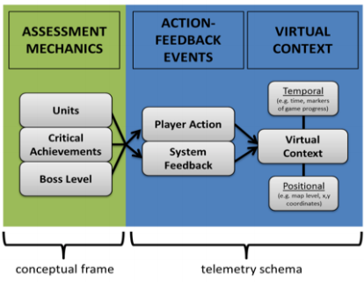
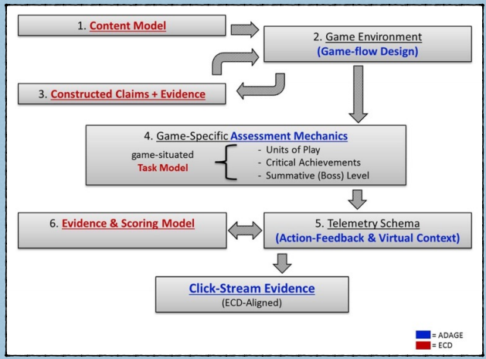
Related work – Applying ECD in ADAGE, for assessments and analytics
ADAGE (Halverson, Owen, 2014) is an open-source data collection and analysis framework that transforms real-time click-stream (telemetry) data from games and other digital learning environments into formative evidence of learning. These data can be used to identify patterns in play within and across players (using data mining and learning analytic techniques) as well as statistical methods for testing hypotheses that compare play to content models.
ADAGE offers a robust framework for defining and specifying how data from games is gathered, stored, and made available to educational researchers, game developers, and classrooms. Overall, the ADAGE framework provides rich, method-agnostic data, scales easily, and is flexible enough to use across a wide range of games and platforms
ADAGE’s context-rich data make ideal building blocks for feature engineering. Features are essentially variables of interest in the data, which can range from simple click locations to complex measures like accuracy over time. These features can then be used across a broad range of analysis techniques. Data lenses can include descriptive statistics, hypothesis-driven applied statistics, and machine learning techniques. Methodologies for hypothesis testing (like ECD) can use ADAGE data as dependent variables, independent variables, and covariates for use in associative or predictive modeling

Slide 14
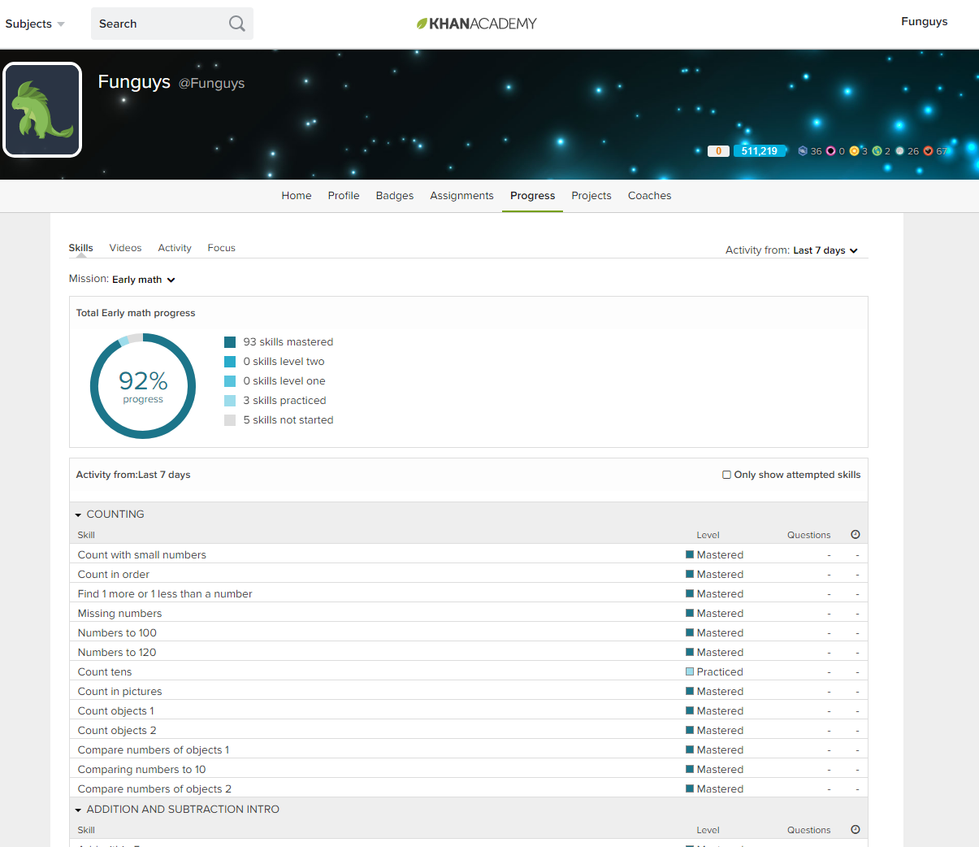
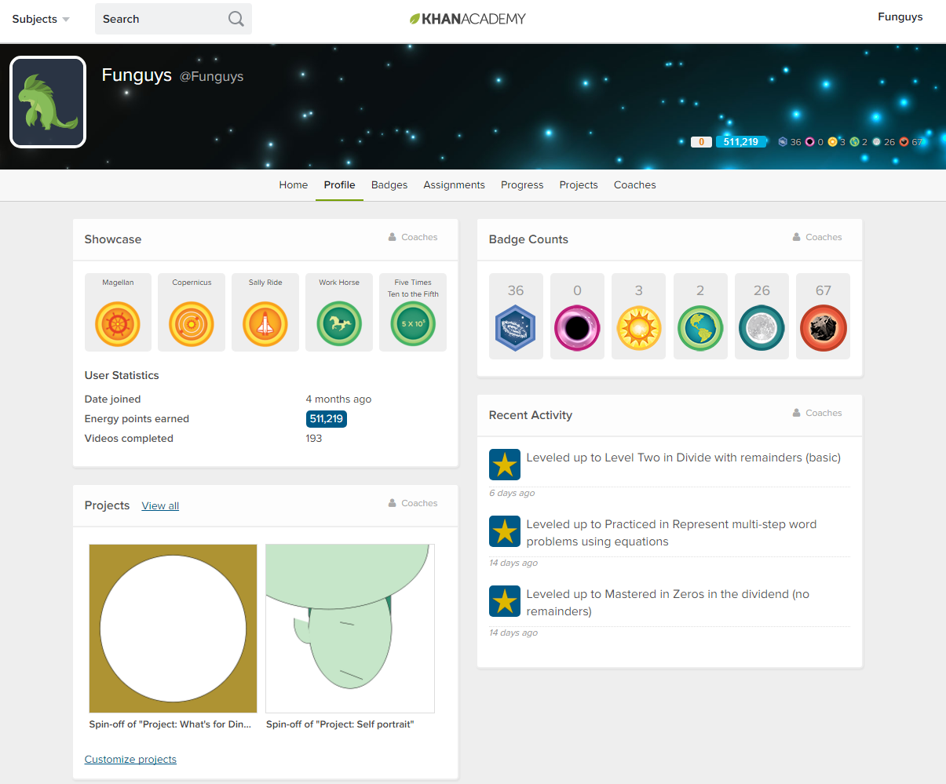
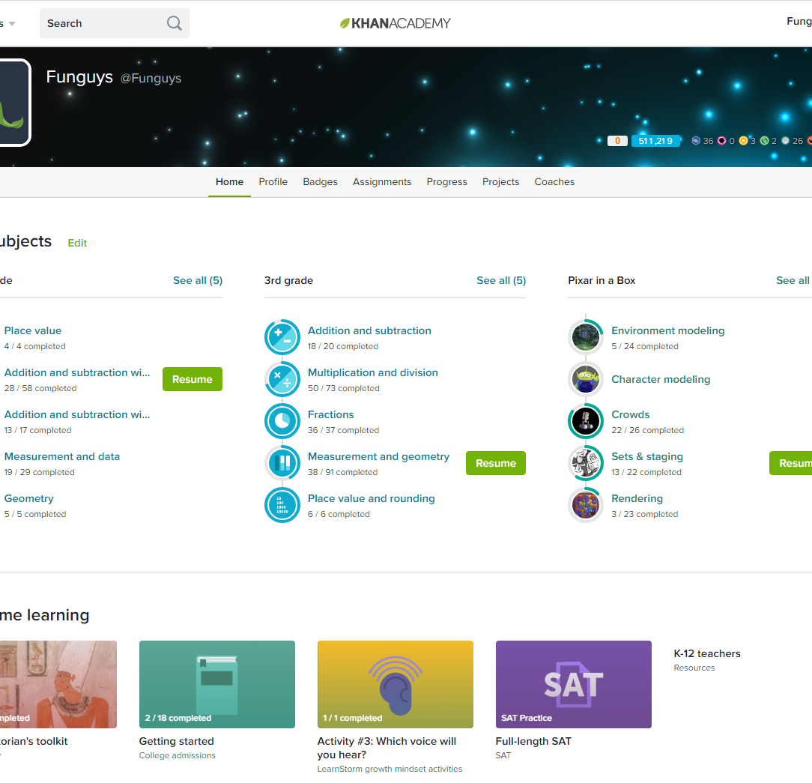
Related work – Khan academy
Tight and unified integrations of front-end and back-end functionalities in production mode
Gamified Accomplishments…
…and Persistent Progress

Slide 15
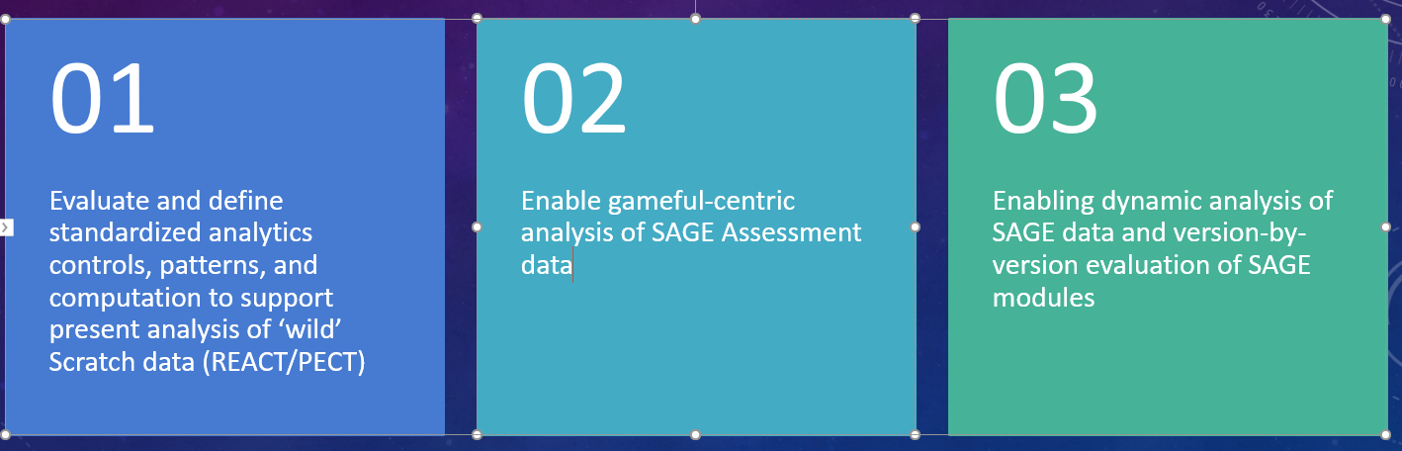
Proposal – realize a gameful evaluation system and analytics framework
Proposed parallel tracks that are in-sync and inform each other:
Responsive and Gameful Assessment
Feature Porting: Enable real-time Gameful assessments in the Node.js version of SAGE to support Gameful Constructionism usage of Scratch
1
Personalized Gameful Assessment: Overhaul fun and inviting Game Objectives in a Gameful UI (Companion Avatar, Companion Interactions , Quantification of Assessed Steps)
3
Uniform Assessment Terminology: Conformation of terminologies and structure into a shared and unified application defined within the SAGE Gameful Assessment Framework
2
Analytics

Slide 16
milestones
10/12
Current State Development Environment Setup
11/09
Successfully port and verify all Go-based Assessment Server functionalities to Node.js
12/15
Add Gameful Constructionism enhancements into the Assessments module
12/23
Final Presentation and Report Submitted
12/31
Software Documentation, SAGE Wiki update, and Code migration to GitHub repositories

Slide 17
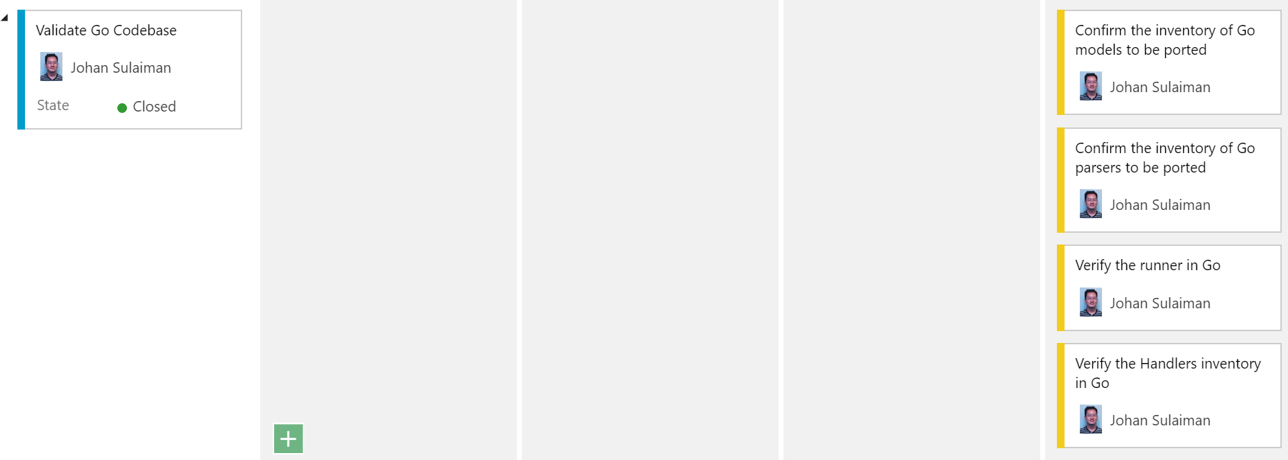
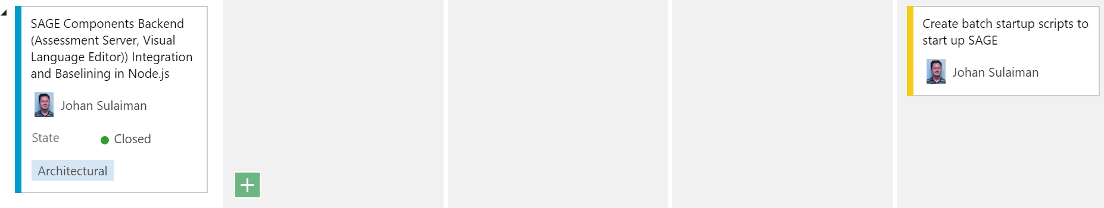
Sprint 1 - Validate Existing Go components

Slide 18
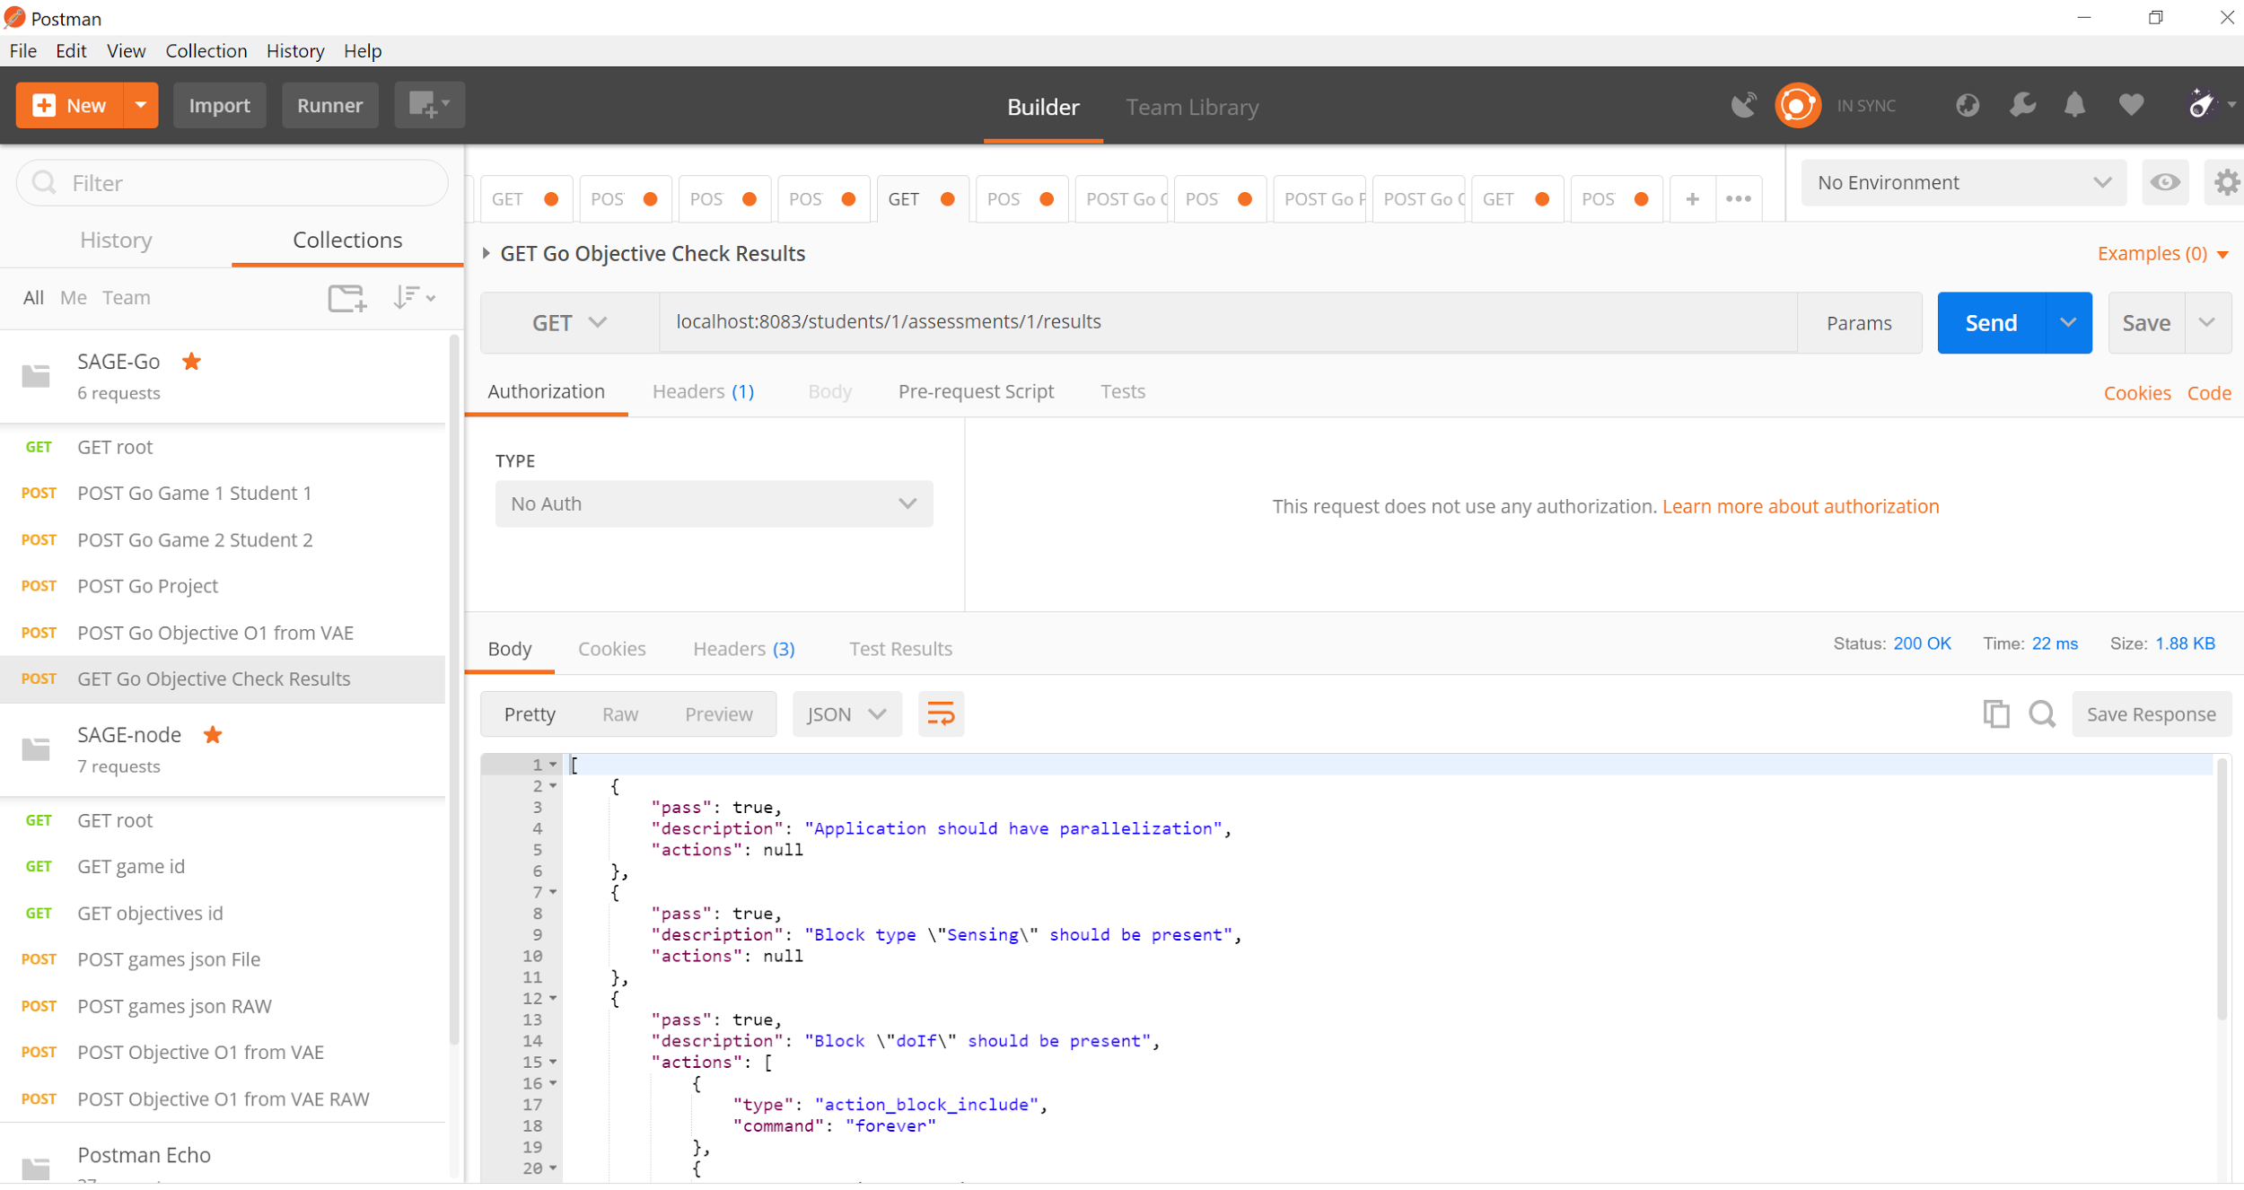
Sprint 1 - Go Validation Method - Postman

Slide 19
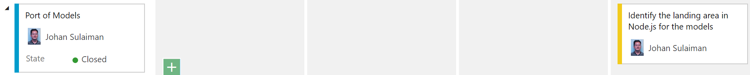
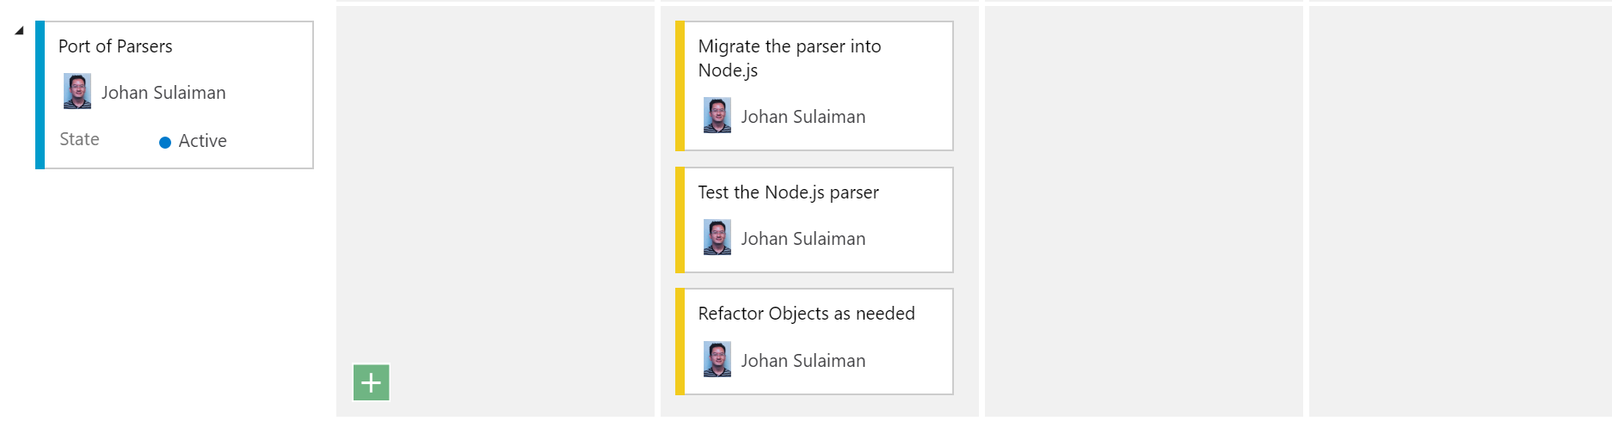
Sprint 2 - Porting and Renaming Models, Handlers, Parsers

Slide 20
Sprint 2 - Porting and Renaming Models, Handlers, Parsers
Some nomenclature changes includes the following
SAGE Assessment Server (Go) | SAGE Assessment Server (Node.js)
Project | game
Assessment | objective
Handlers | controller (Router)

Slide 21
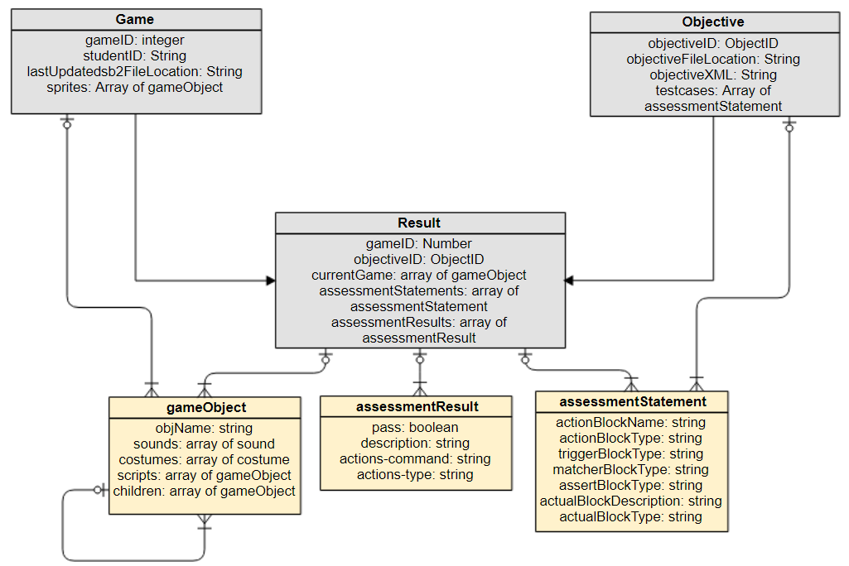
Sprint 2 - Games and Objectives MongoDB ODM

Slide 22
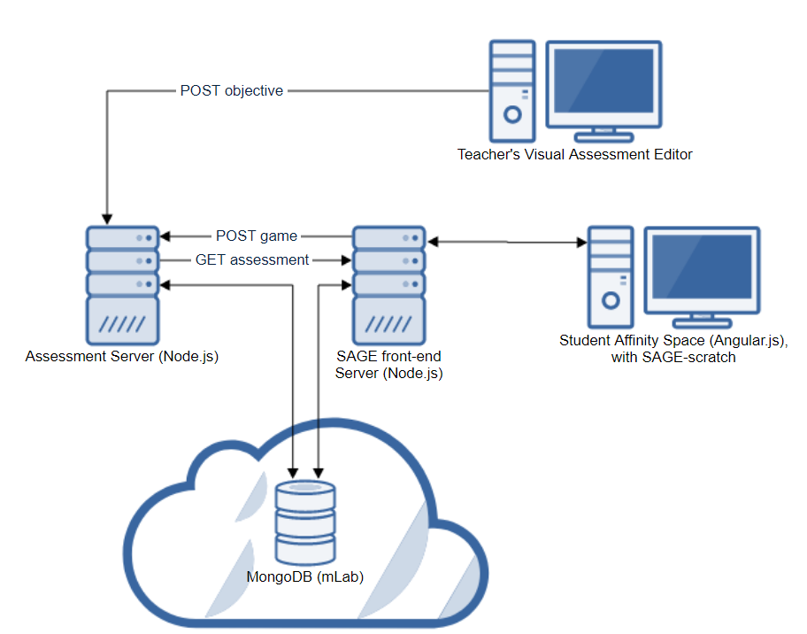
Sprint 3 – VALE, node, and affinity space integration
End-to-end data flow envisioned by past researchers Is now closer at hand, with capability to transfer new data elements (timer on/off, timer limit, sage chat bubble, etc.)

Slide 23
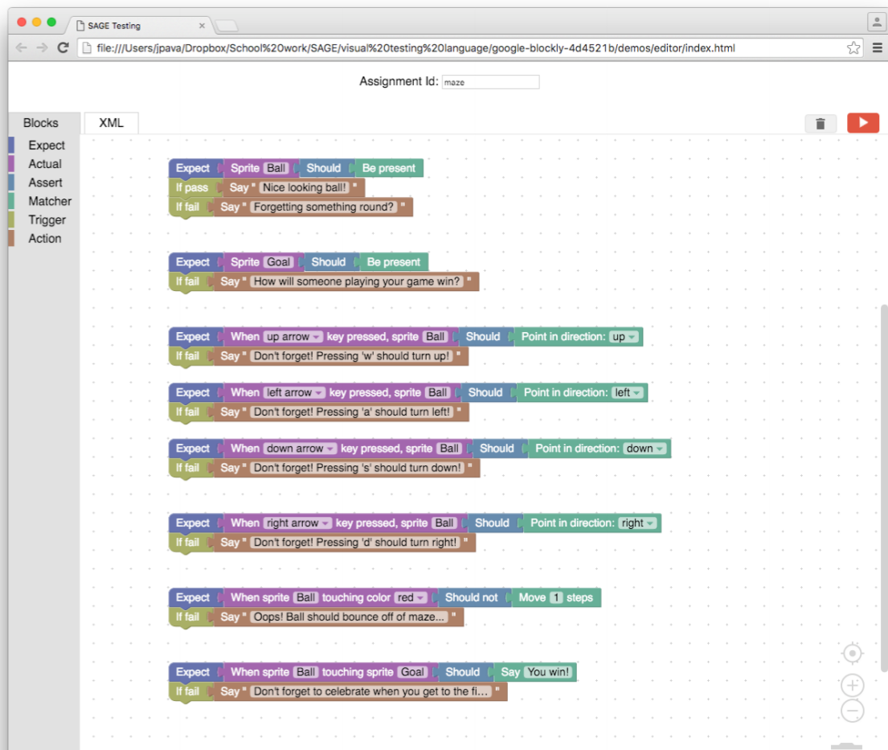
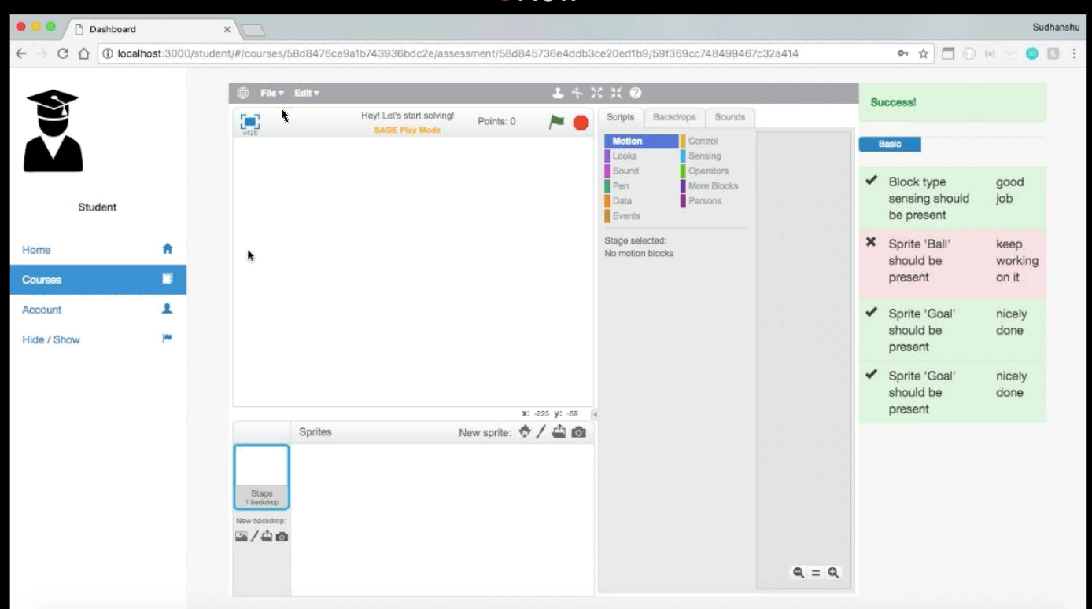
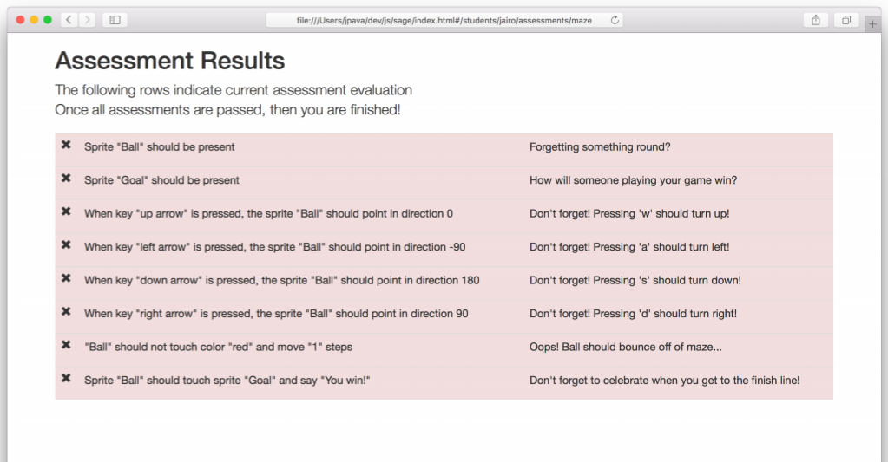
Sprint 4 – gamified ui/ux
Trying to answer the challenge: How to present instructional information through a gameful, even addicting User Experience

Slide 24
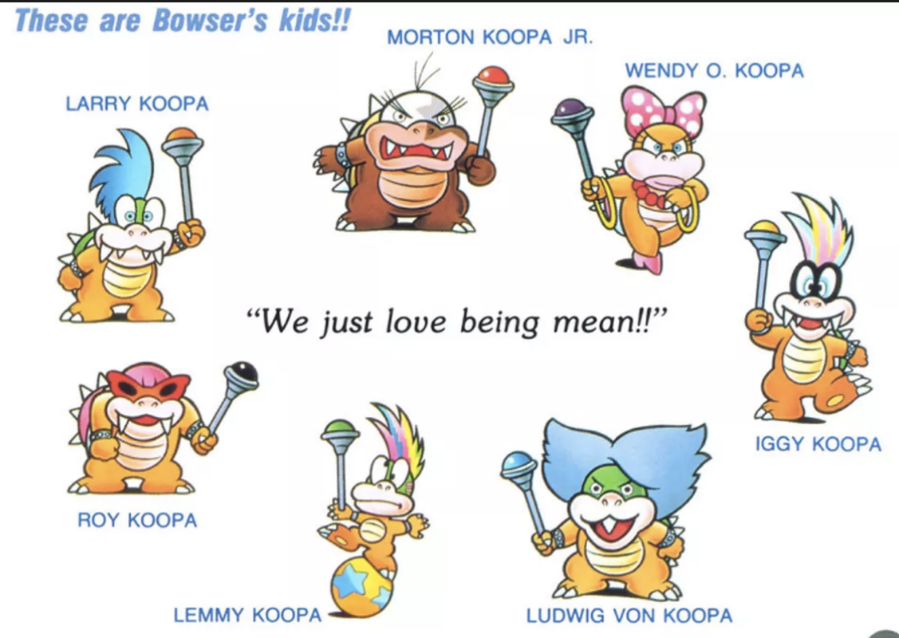
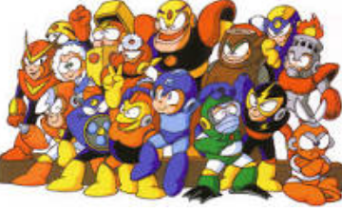
Sprint 4 – gamified ui and ux
Possible Game name: Sages!
Quests as Stages/Levels, each having its own Sage as the Boss of that Stage (similar to Bowser and his sons in Super Mario, or stage bosses in Mega Man)
Example: Sage of Recursion, the Loopy Sage, Sage of Data, each with its own personality, character design, “special powers/moves”, speech pattern, and idiosyncrasies
Minimize clutter and text in the UI
Gamify the assessment result by renaming them as “SAGE orb”

Slide 25

Sprint 4 – gamified ui and ux
Personalizing the Sage as a character to encourage Social, Gameful feel
Chat bubble with customizable, dynamic, periodically updated script from VAL Editor
Presence of a felt-character opens up possibilities and imaginations for Gameful and Addicting
storylines, drama, comedy, and even action and conflict
Good foil for the functioning of the back-end machine learning algorithms and Intelligent Tutoring features
Add a Timer to add dimension into the gaming experience
Induce a healthy level of “good” tension that is conducive to higher learning rate, creativity, and productivity
Present a gaming challenge that could add Gamefulness through competitiveness
Can be used to Socially display personal and community high-scores using time as a common constraint that establishes a universal benchmark
Also useful in classroom setting, or future SAGE research purposes
Adds another metric/feature/variable for progress tracker, analytics and machine learning algorithms

Slide 26
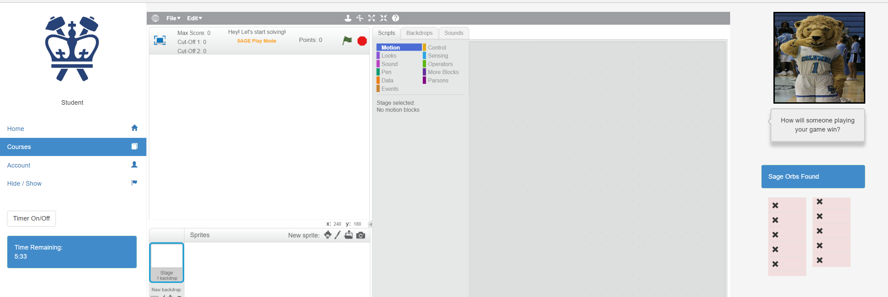
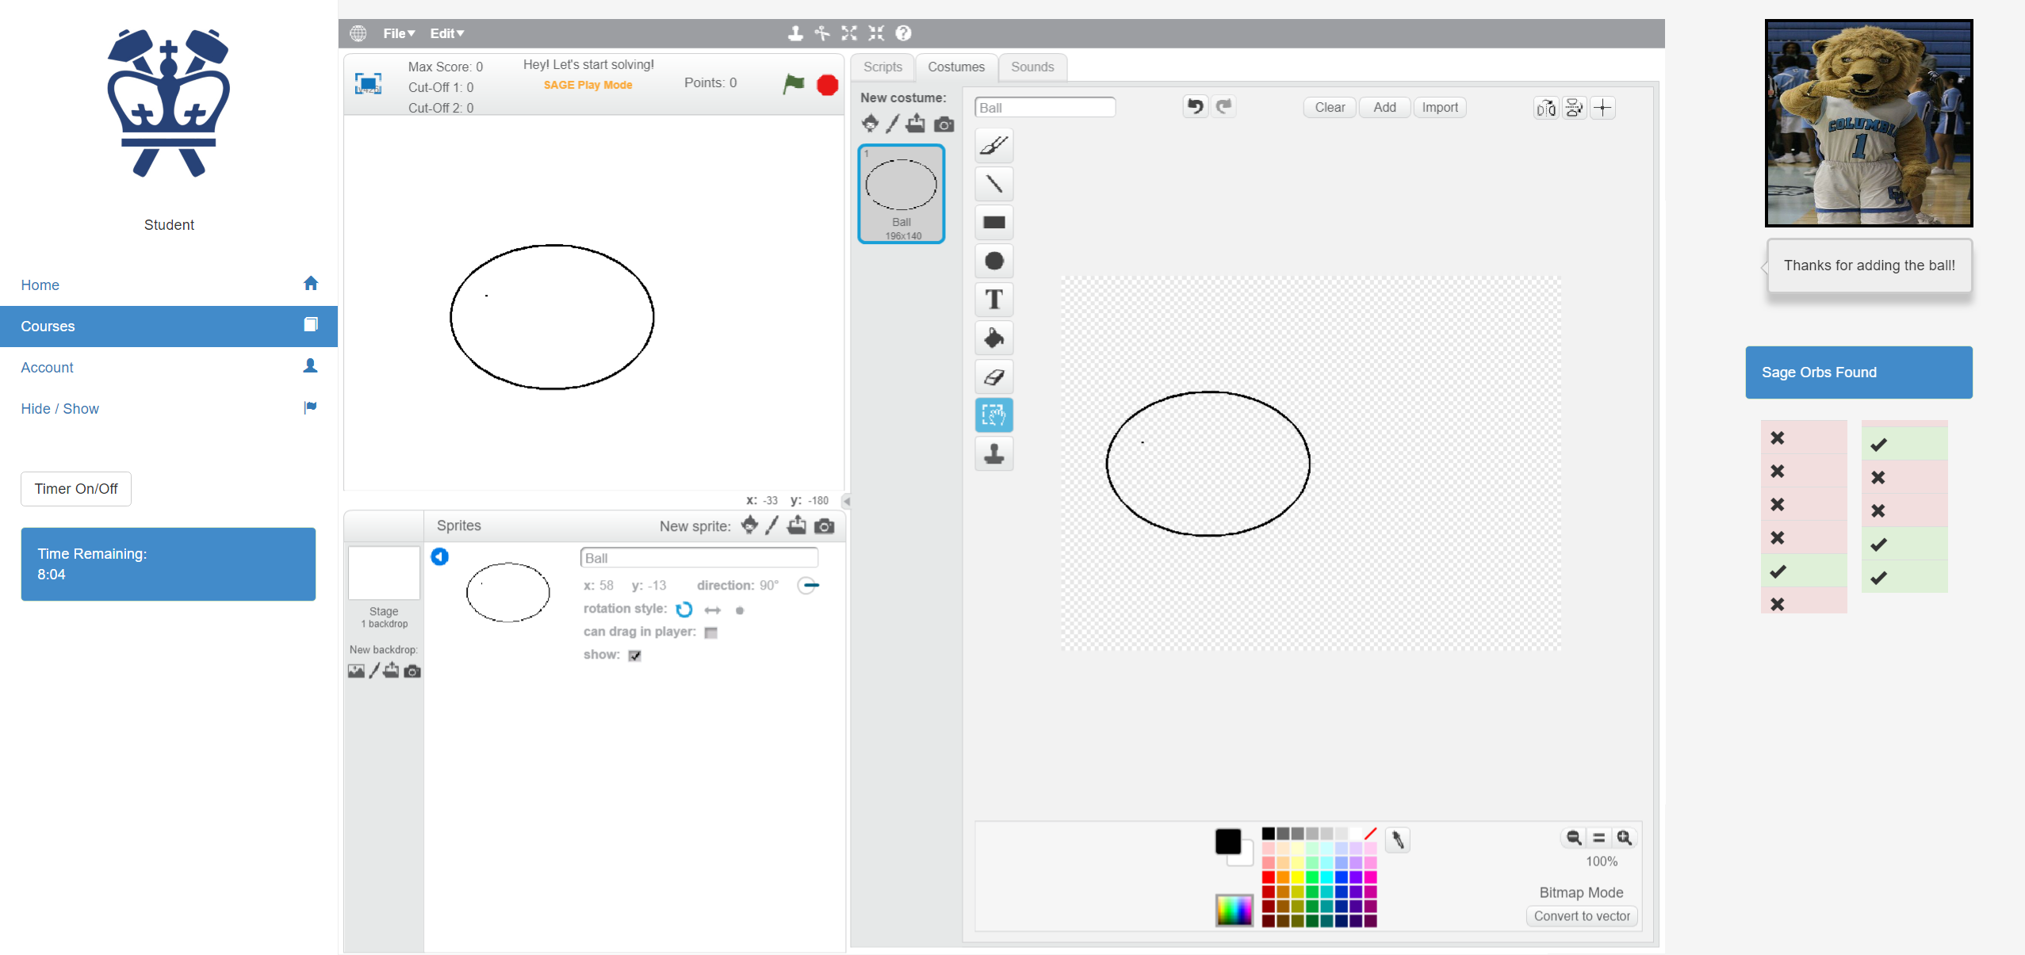
Sprint 4 – gamified ui and ux

Slide 27
Looking Ahead
Complete the integration between SAGE-scratch, SAGE-node, and SAGE-Affinity Space
Put Sage bar into a standalone sidebar
Add a Sages! Game banner header in the main Affinity Space view
Create skins to allow interchangeable objects and elements
Enable periodic updates of game into SAGE-node and Assessment Results into SAGE-Affinity Space
Add Set Suggested Timer in Visual Assessment Editor
Add Gameful Constructionism enhancements into the Assessments module
Showing Earned Points and Target Points
Introduce a Timer, Timer (On, Off toggle), Timer Expiration Event, and High Score
Sage’s dynamic chat bubble
Notes:
Feedback:
How to handle Progress and Game receiving sb2s one-time? Accept the entire sb2 game (the full project). Want to avoid sending updates twice (to Progress and Game).
Editor sends JSON and full sb2, being handled by Progress, supposed to save JSON every second, and the full sb2 on Save.
Integrate Progress, Game, Objective.
Currently Progress in Node can accept Editor sb2 via REST api POST
Is there a GET back to Editor? Look into FetchAssignmentProgress.
We need to load Scratch Editor from the Assessment Server instead of file system.

Slide 28
Future work
Create a story for each concept (Conditionals, Data, Events, Loops), practice, and perspective outlined in the curriculum
Progress tracker and indicator
Save and retrieve progress over-time, saves high-score for replayability and ‘groking’ of concepts
Setup A/B Testing capabilities of SAGE Features
Setup Test environment for research with controlled subjects
Milestone, rewards, and feedback upon game completion
Update the Sages! Game Design Studio with additional Sage design tools
Integrate Intelligent Tutoring with the character-driven Sage bosses

Slide 29
Core references
Bender, J., 2014. “Scratch Analyzer: Transforming Scratch Projects into Inputs Fit for Educational Data Mining and Learning Analytics,” Columbia University, New York, NY
Bender, J., March, 2015. Tooling Scratch: Designing a Collaborative Game-Based Learning System to Infuse Computational Thinking within Grade 6-8 Curricula - Midterm Paper" Columbia University, New York, NY
Berland, M., Baker, R.S. & Blikstein, P., 2014. Educational Data Mining and Learning Analytics: Applications to Constructionist Research. Technology, Knowledge and Learning, Volume 19, Issue 1-2, pp 205-220.
B. Boe et al., 2013. "Hairball: Lint-inspired static analysis of scratch projects," in Proceeding of the 44th ACM technical symposium on Computer science education
Carvalho, M. B., 2017. Serious games for learning : a model and a reference architecture for efficient gamedevelopment Eindhoven: Technische Universiteit Eindhoven
Groff, J., Clarke-Midura J., Owen, V.E., Rosenheck, L., Beall, M., 2015. Better Learning in Games: A Balanced Design Lens for a New Generation of Learning Games
Koh, K. H., Basawapatna, A., Nickerson, H., Repenning, A., 2014. Real Time Assessment of Computational Thinking, IEEE International Symposium on Visual Languages and Human-Centric Computing, Melbourne, Australia
Kickmeier‐Rust, M. D. and Albert, D., 2010. "Micro‐adaptivity: protecting immersion in didactically adaptive digital educational games," Journal of Computer Assisted Learning, vol. 26, no. 2, pp. 95-105
Halverson, R. & Owen, V.E., 2014. Game-Based Assessment: An Integrated Model to Capture Evidence of Learning in Play. International Journal of Learning Technology, 9(2), 111–138M. D. Kickmeier‐Rust and D. Albert, 2010. "Micro‐adaptivity: protecting immersion in didactically adaptive digital educational games," Journal of Computer Assisted Learning, vol. 26, no. 2, pp. 95-105
SAGE Wiki. (2016, September). Columbia Programming Systems Lab. Retrieved September 2016, from SAGE Wiki: https://gudangdaya.atlassian.net/wiki/spaces/SAGE/pages/60293127/Getting+Started
Seiter, L. and Foreman, B., 2013, August. Modeling the learning progressions of computational thinking of primary grade students. In Proceedings of the ninth annual international ACM conference on International computing education research (pp. 59-66).ACM
Wing, J. M., 2006. "Computational thinking," Communications of the ACM, vol. 49, no. 3, p.33

